Slide 1
Banking Fishbone Template
Chris Nichols
Director of Capital Markets

Slide 2
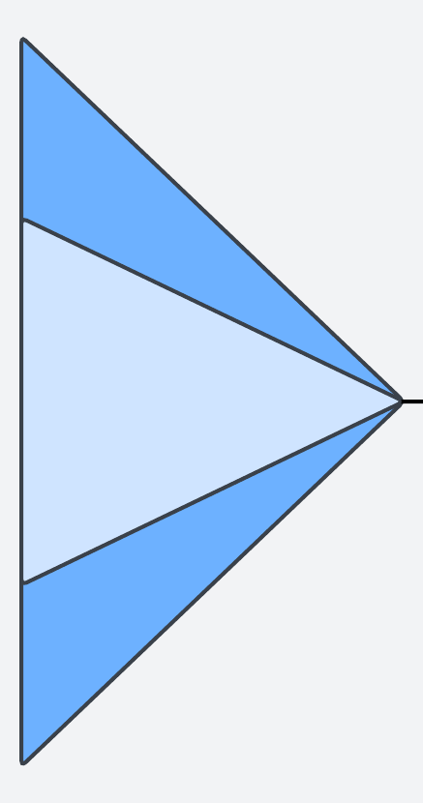

Fishbone (Ishikawa) Diagram Template
Environment/Timing/
Competition
Technology
Management/
Measurement
Economic Model
Cause 1
Cause 1
Cause 1
Cause 1
Cause 2
Cause 2
Cause 2
Cause 2
Cause 3
Cause 3
Cause 3
PROBLEM STATEMENT
Cause 3
Cause 3
Cause 3
Cause 2
Cause 2
Cause 2
Cause 2
Cause 1
Cause 1
Cause 1
Cause 1
People / Training
Process
Risk/Compliance
Marketing/Education

Slide 3
Branch Performance Decline
People
  - Low sales culture
  - High turnover
  - Insufficient training
Processes
  - Slow onboarding
  - Manual teller operations
Technology
  - Legacy teller stack
  - No appointment automation
Risk
  - Audit delays
  - Operational bottlenecks
Market
  - Competitors with more ATMs
  - Customer preference shift
Metrics
  - No cross-sell scorecard
  - Dated branch KPIs

Slide 4
ACH Fraud Payment Loss
People
  - Manual review fatigue
  - Weak fraud training
Processes
  - Missing dual controls
  - Slow exception review
Technology
  - No behavioral analytics
  - Alerts not real-time
Risk
  - Weak onboarding controls
  - Incomplete KYC enrichment
Market
  - Fraud rings evolving rapidly
Metrics
  - Fragmented fraud dashboards
  - No loss attribution by type

Slide 5
Commercial Credit Deterioration
People
  - RM portfolio gaps
  - Specialized credit skills lacking
Processes
  - Annual review delays
  - Weak covenant tracking
Technology
  - No real-time financial feeds
  - Outdated scoring models
Risk
  - Poor early warning triggers
Market
  - Sector downturns
  - Margin pressure across industries
Metrics
  - RAROC not monitored
  - No segment risk dashboard

Slide 6
Commercial Customer Churn
People
  - Low RM outreach cadence
Processes
  - Clunky onboarding
  - No proactive renewals
Technology
  - CRM outdated
  - No churn prediction model
Risk
  - Unresolved service issues
Market
  - Competitors offering bundled fees
Metrics
  - No churn KPIs
  - No root-cause reporting

Slide 7
Stablecoin Go-to-Market Acceptance
People
  - Low Web3 readiness internally
Processes
  - Slow onboarding of pilot firms
Technology
  - Complicated wallet UX
  - API friction
Risk
  - Regulatory uncertainty
  - Compliance friction
Market
  - Enterprise hesitation
  - Well-known competitor coins
Metrics
  - No GTM funnel tracking
  - No adoption curves measured

Slide 8
DISCLAIMER
This presentation is for general strategic information only and should not be relied upon as a substitute for independent research before making a material management decision. This presentation does not take into account any particular bank’s performance objectives, financial situation or needs. All banks should obtain advice based on their unique situation before making any decision based upon this presentation or any information contained within. In addition, any implied projections or views of the bank market provided by the author(s) may not prove to be accurate. While all the information contained herein is believed to be accurate as of the date of source or publication, the information is subject to change and revision.

